Slide 1
Data Visualisation Lecture Week 10 – Visualising Geospatial Data
Dr. Cathy Ennis

Slide 2
Learning Outcomes Week 10
Analyse and evaluate how mental models aid in the interpretation of complex visual displays.
Select, formulate and integrate metaphors to suit data-driven tasks
Create and deploy successful data visualisations using leading software tools
Demonstrate an understanding how visualisation is used in date journalism to communicate complex ideas and stories

Slide 3
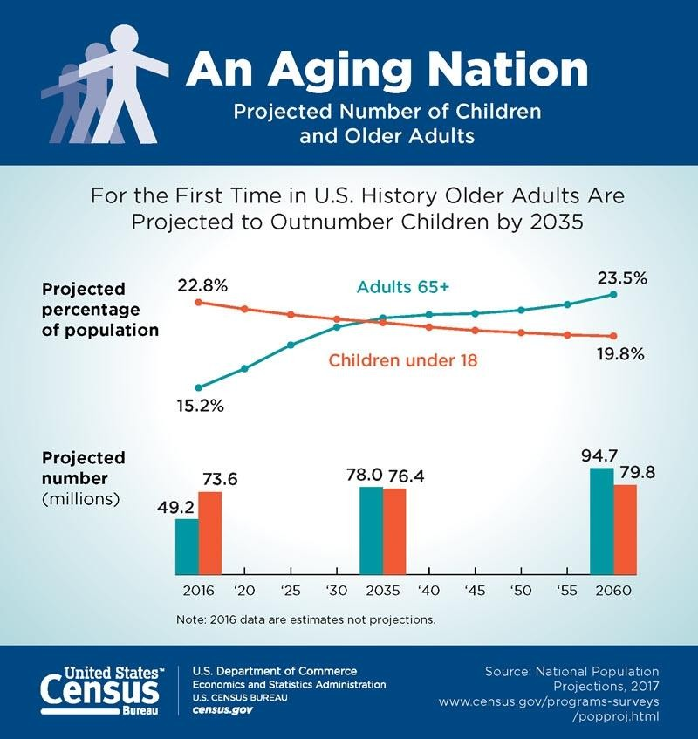
Visualisation of the Week
Notes:
Already, the middle-aged outnumber children, but the country will reach a new milestone in 2034 (previously 2035). That year, the U.S. Census Bureau projects [PDF] that older adults will edge out children in population size: People age 65 and over are expected to number 77.0 million (previously 78.0 million), while children under age 18 will number 76.5 million (previously 76.7 million).
Japan has the world’s oldest population, where more than one in four people are at least 65 years old. Already, its population has started to decline and, by 2050, it is projected to shrink by 20 million people.
Fewer babies + longer life expectancy = aging population

Slide 4
Overview
In this lecture we will cover:
Introduction to spatial relationships
Map projections
ggplot commands for basic visualisations

Slide 5
INTRODUCTION

Slide 6
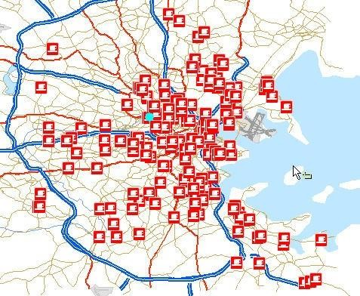
Introduction
Maps are a sub-category of visualisation
Maps are
usually very intuitive
a great way to understand your data
essentially scaled down, accurate versions of the physical world
Notes:
Viewers of all ages can read them
They are everywhere

Slide 7
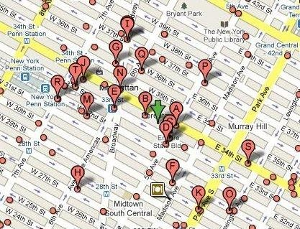
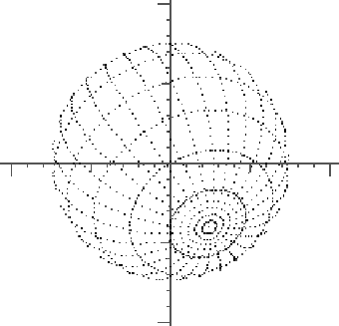
What To Look For
You read maps much the same way that you read statistical graphics
You still look for clustering in or comparisons of specific regions
Notes:
When you look at specific locations on a map, you still look for clustering in specific regions or for example, compare one region to the rest of a country. The difference is that instead of x- and y-coordinates, you deal with latitude and longitude. The coordinates on a map actually relate to each other in the same way that one city relates to another. Point A and Point B are a specific number of miles away, and it takes an estimated time to get there. In contrast, the distance on a dot plot is abstract and (usually) has no units.
The New York Times has a group of people in its graphics department who exclusively design maps. You need to make sure all your locations are placed correctly, colors make sense, labels don’t obscure locations, and that the right projection is used.

Slide 8
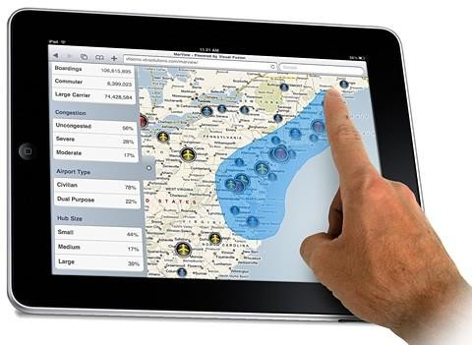
What To Look For
Things can get especially interesting when you introduce time
A single map represents a moment in time, but you can represent multiple timeframes with several maps
small multiples
Can also animate changes If the map is interactive, readers can easily focus in on their area to see how things have changed

Slide 9
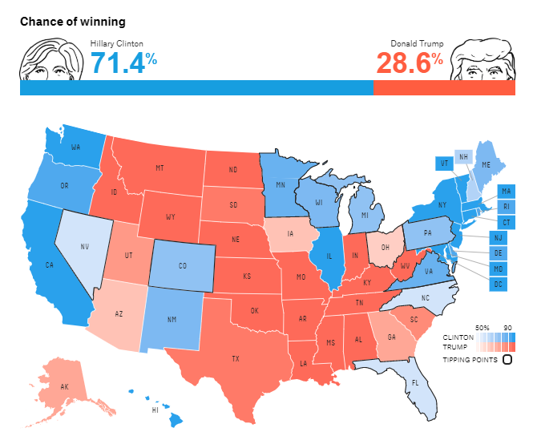
Clinton V Trump
https://projects.fivethirtyeight.com/2016-election-forecast/

Slide 10
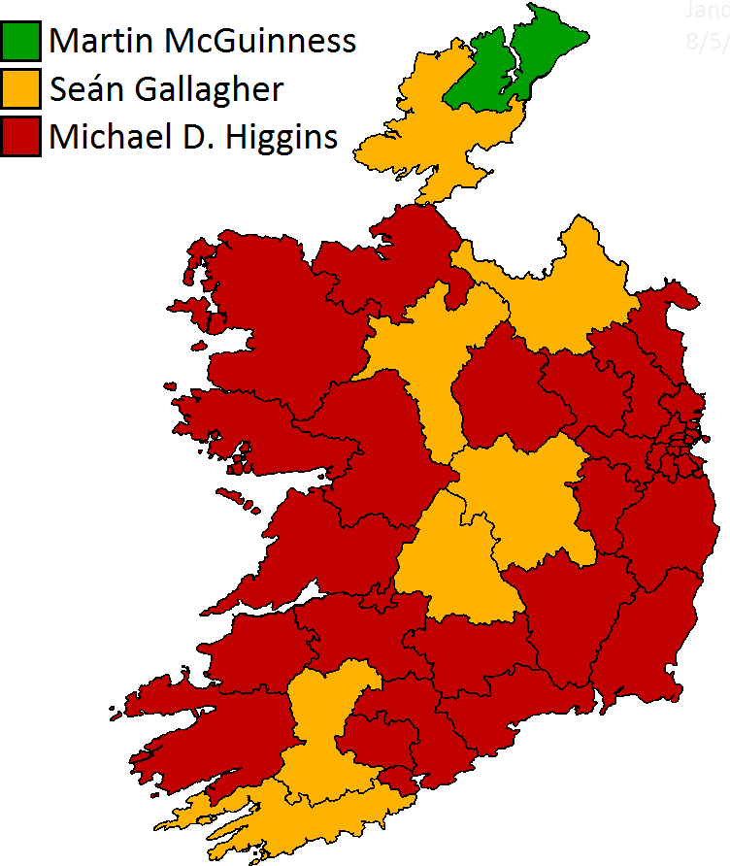
Irish Elections
http://irishpoliticalmaps.blogspot.com/2011/10/irish-presidential-election-2011.html

Slide 11
MAP PROJECTIONS
Notes:
Google and Microsoft provide straightforward tutorials that start with their mapping APIs, so be sure to check those out if you’re interested in taking advantage of some basic mapping functionality e.g., mapping a list of locations with latitude and longitude.

Slide 12
Map Projections
A map projection is a method used to represent the 3- dimensional surface of the earth or other round body on a 2-dimensional plane in cartography
This process is typically a mathematical procedure and the resulting 2D image is always a distorted version of reality
The metric properties of a map are:
Area – Equal area projections maintain this
Shape – Conformal projections maintain this
Direction
Distance
Scale
https://www.gislounge.com/map-projection/
Notes:
Geospatial visualizations are one of the earliest forms of information visualizations. They were used historically for navigation and were essential tools before the modern technological era of humanity – many of our earlier well known visualisations represented spatial relationships

Slide 13

Types of Projections
Azimuthal or zenithal - Preserves direction from one or two points to every other point
Conformal - Preserves shape locally
Equal-area - Preserves area
Equidistant - Preserves distance between one or two points and every other point
Notes:
If a surface can be transformed onto another surface without stretching, tearing, or shrinking, then the surface is said to be an applicable surface. The sphere or ellipsoid are not applicable with a plane surface so any projection that attempts to project them on a flat sheet will have to distort the image (similar to the impossibility of making a flat sheet from an orange peel).
It is impossible to construct a map projection that is both equal area and conformal.

Slide 14
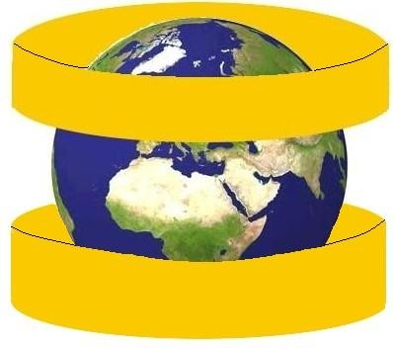
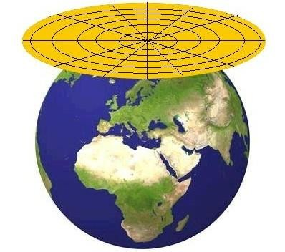
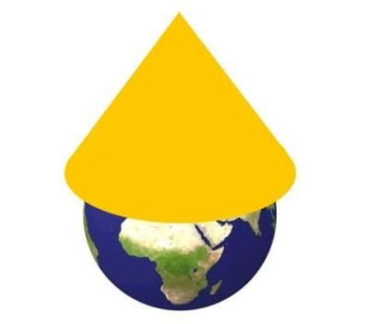
Map Projections
Cylinder, plane, and cone projections
“Interactive Data Visualisation”, M. Ward, G Grinstein & D Keim, AK Peters, 2010

Slide 15
Map Projections – Cylinder Projection
Straight coordinate lines with horizontal parallels crossing meridians at right angles
All meridians are equally spaced
Scale is consistent along each parallel
“Interactive Data Visualisation”, M. Ward, G Grinstein & D Keim, AK Peters, 2010
Notes:
Cylindrical map projections are one way of portraying the Earth. This kind of map projection has straight coordinate lines with horizontal parallels crossing meridians at right angles. All meridians (lines connecting longitude) are equally spaced, and the scale is consistent along each parallel. (latitude)

Slide 16
Map Projections – Cone Projection
Cone projections are defined by the cone constant
dictates the angular distance between meridians
Meridians are equidistant and straight lines which converge in locations along the projection regardless of if there’s a pole or not
“Interactive Data Visualisation”, M. Ward, G Grinstein & D Keim, AK Peters, 2010

Slide 17
Map Projections – Plane Projection
Azimuthal projection is a projection of the globe onto a plane
Straight meridian lines, radiating out from a central point, parallels that are circular around the central point, and equidistant parallel spacing
“Interactive Data Visualisation”, M. Ward, G Grinstein & D Keim, AK Peters, 2010
Notes:
An azimuthal projection is a projection of the globe onto a plane. They have straight meridian lines, radiating out from a central point, parallels that are circular around the central point, and equidistant parallel spacing

Slide 18
Map Projections
Cylinder projections
Mercator
Lambert cylindrical
Galls-Peters
Plane projections
Gnomonic
General perspective
Cone projections
Albers conic
Lambert conic
Compromise projection
Winkel Tripel
“Interactive Data Visualisation”, M. Ward, G Grinstein & D Keim, AK Peters, 2010

Slide 19
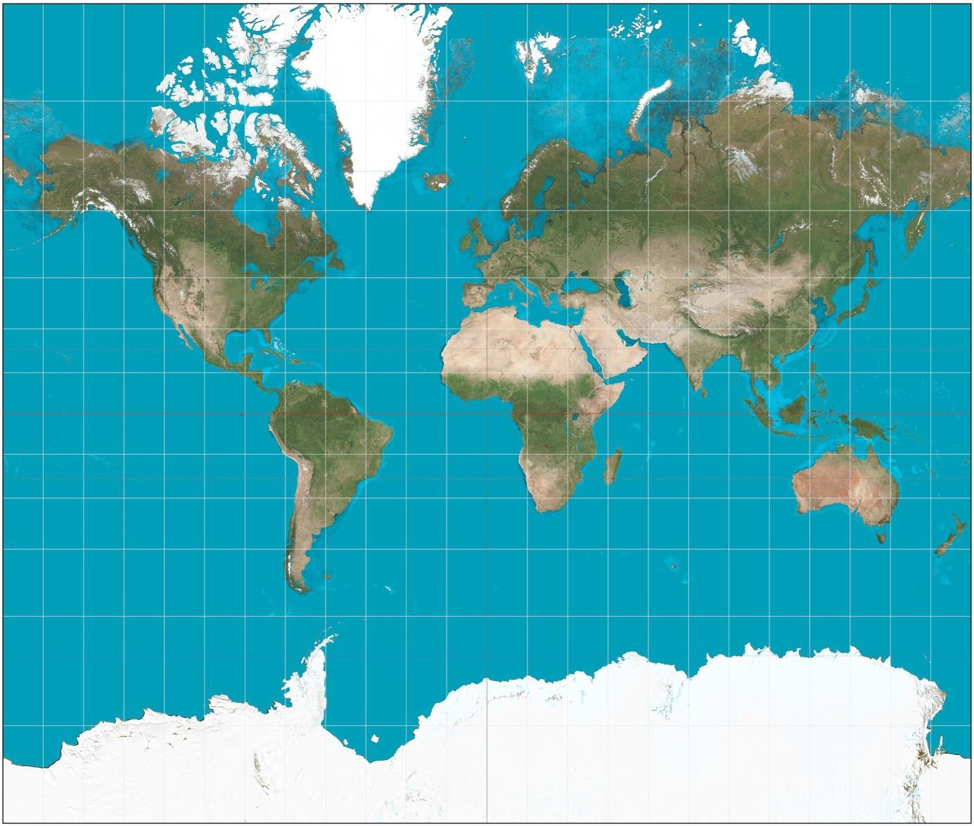
Mercator Projection
http://en.wikipedia.org/wiki/File:Mercator_projection_SW.jpg

Slide 20
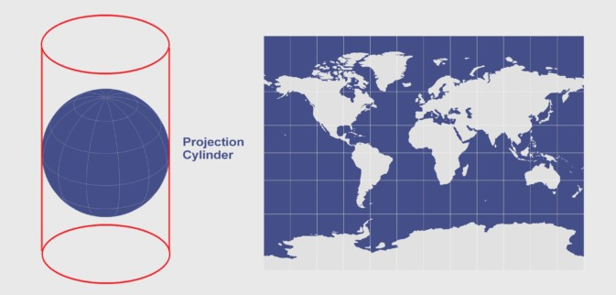
Mercator Projection
https://gisgeography.com/cylindrical-projection/

Slide 21
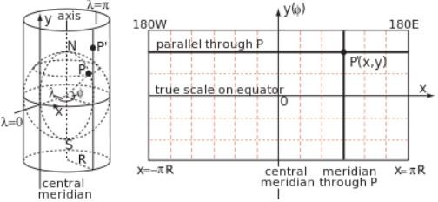
Mercator Projection
By Peter Mercator - Own work, CC BY-SA 3.0, https://commons.wikimedia.org/w/index.php?curid=20168429

Slide 22
Mercator Projection
Mercator map projection (1569) shows true direction between places the best, but are not equal area or equidistant
This is the projection of choice from Google maps for this reason, despite how the south and north poles distort land size
Directions along a rhumb line (line of constant direction) are true between any two points on a map
Distances are true only along the Equator
Although it has a conformal property, areas are greatly distorted increasing size at poles
Notes:
conformal property- shape is preserved

Slide 23


Mercator Projection
The formulae for calculating the x and y coordinates for a point in a Mercator projection are:
where λ is a longitude, Φ is a latitude and W is the width of the map

Slide 24
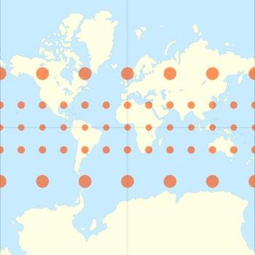
Notes:
Tissot's indicatrix (Tissot indicatrix, Tissot's ellipse, Tissot ellipse, ellipse of distortion) (plural: "Tissot's indicatrices") is a mathematical contrivance presented by French mathematician Nicolas Auguste Tissot in 1859 and 1871 in order to characterize local distortions due to map projection

Slide 25
Mercator Projection
The Mercator projection exaggerates areas far from the equator, for example:
Greenland takes as much space on the map as Africa, when in reality Africa's area is 14 times greater and Greenland's is comparable to Algeria's alone.
Alaska takes as much area on the map as Brazil, when Brazil's area is nearly five times that of Alaska
Finland appears with a greater north-south extent than India, although India's is greater
Antarctica appears as the biggest continent, although it is actually the fifth in terms of area
http://en.wikipedia.org/wiki/Mercator_projection

Slide 26
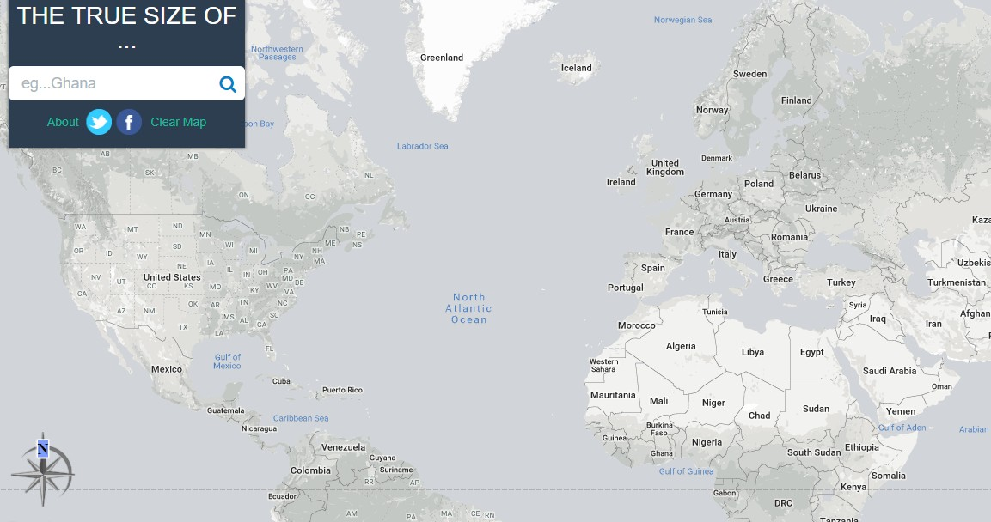
Mercator Projection
Compare size of Iceland and Ecuador
http://thetruesize.com

Slide 27
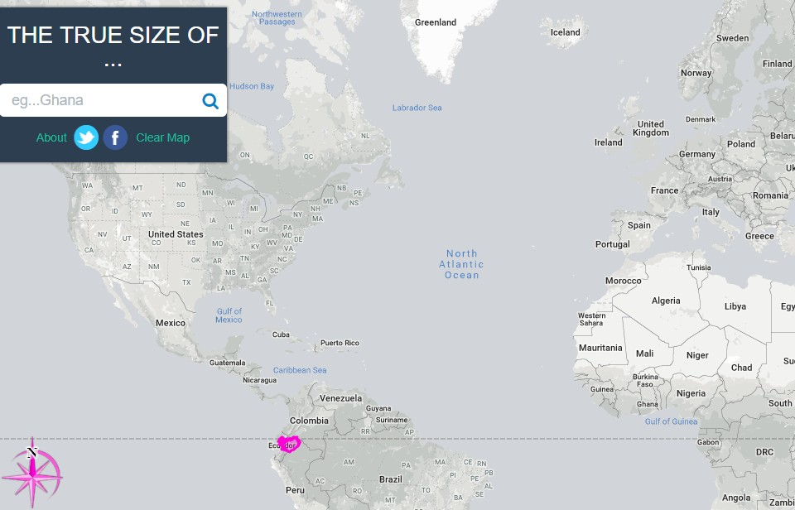
Mercator Projection
http://thetruesize.com

Slide 28
Lambert Cylindrical Projection
Cylindrical equal area projection (1772)
This projection is undistorted along the equator, which is its standard parallel, but distortion increases rapidly towards the poles
Like any cylindrical projection, it stretches parallels increasingly away from the equator. The poles accrue infinite distortion, becoming lines instead of points

Slide 29
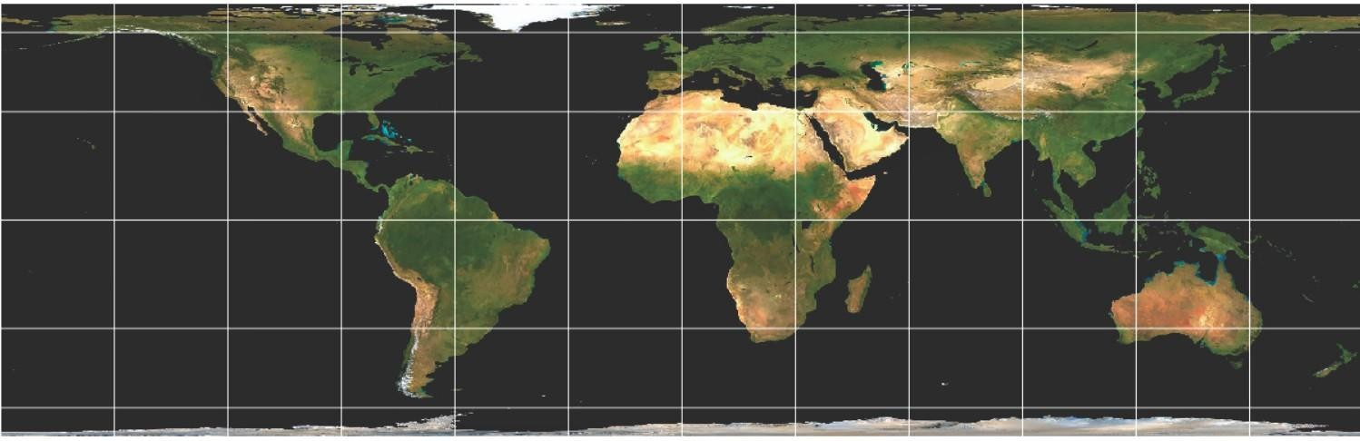
Lambert Cylindrical Projection
"Interactive Data Visualisation", M. Ward, G Grinstein, D Keirn, AK Peters, 2010

Slide 30
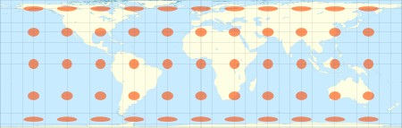
Lambert Cylindrical Projection
"Interactive Data Visualisation", M. Ward, G Grinstein 8: D Keirn, AK Peters, 2010

Slide 31
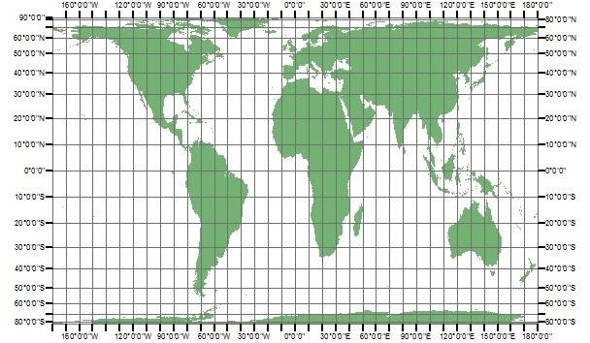
Gall-Peters Projection
Equal area, cylindrical projection (1855-1973)
Standard parallels 45° N/S
All areas on the map are equal in size and all meridians and parallels are mapped as straight lines
A downside with Gall-Peters projection is that it is geometrically inaccurate even around the equator
Notes:
Gall-Peters projection wraps a cylinder around the earth and maps each point on the earth to the nearest point on the cylinder
Distorts around the equator unlike Lambert

Slide 32
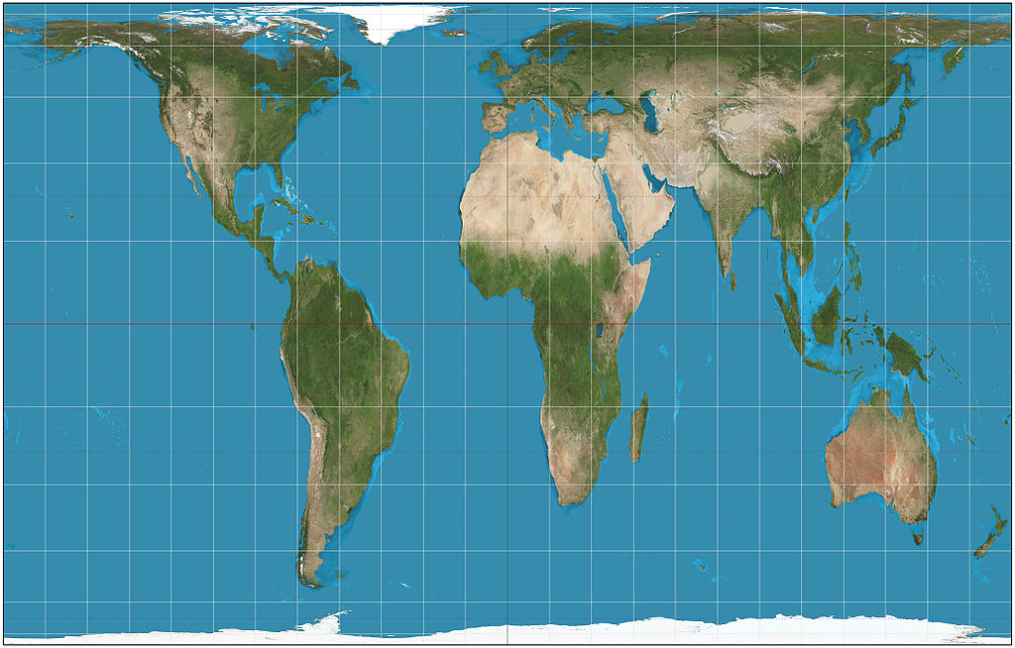
Gall-Peters Projection
https://en.wikipedia.org/wiki/Gall%E2%80%93Peters_projection#/media/File:Gall%E2%80%93Peters_projection_SW.jpg

Slide 33
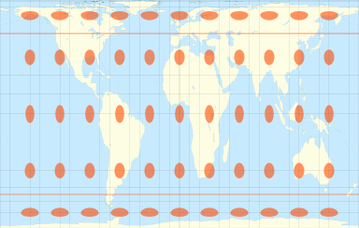
Gall-Peters Projection
https://en.wikipedia.org/wiki/Gall%E2%80%93Peters_projection#/media/File:Tissot_indicatrix_world_map_Gall-Peters_equal-area_proj.svg

Slide 34
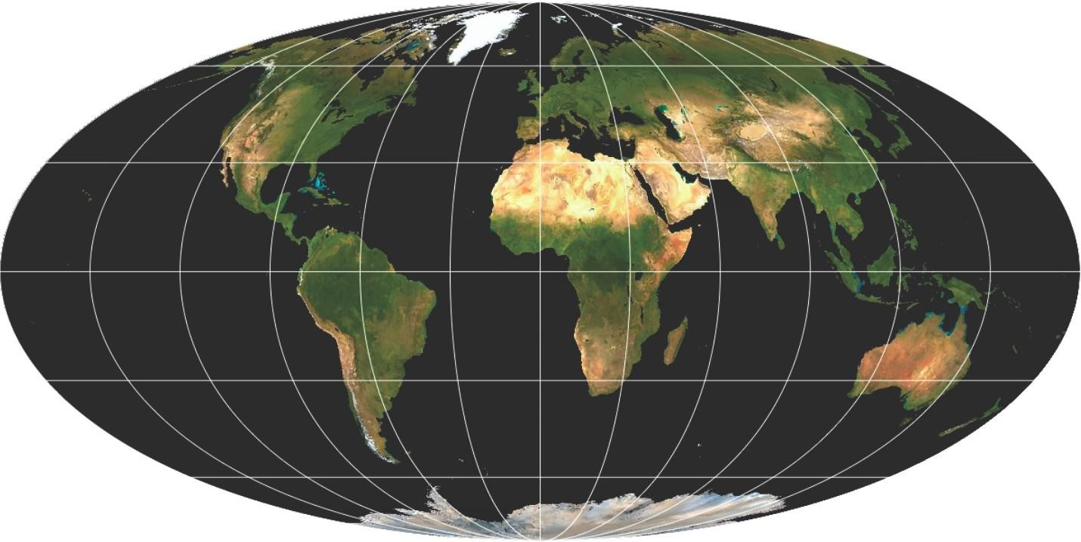
Mollweide Projection
Equal area
Pseudocylindrical
Non conformal - trades accuracy of shape and angle for area accuracy
Converging meridians and straight parallels
Used for maps where area is needed e.g., global distribution
Ocean areas and sky
"Interactive Data Visualisation", M. Ward, G Grinstein 8: D Keirn, AK Peters, 2010
Notes:
The projection trades accuracy of angle and shape for accuracy of proportions in area, and as such is used where that property is needed, such as maps depicting global distributions
Conformal map projections preserve angles if two roads cross each other at a 39° angle, then their images on a map with a conformal projection cross at a 39° angle.

Slide 35
Mollweide Projection
"Interactive Data Visualisation", M. Ward, G Grinstein 8: D Keirn, AK Peters, 2010
Notes:
The projection trades accuracy of angle and shape for accuracy of proportions in area, and as such is used where that property is needed, such as maps depicting global distributions
Conformal map projections preserve angles if two roads cross each other at a 39° angle, then their images on a map with a conformal projection cross at a 39° angle.

Slide 36
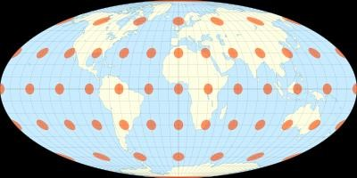
Mollweide Projection
"Interactive Data Visualisation", M. Ward, G Grinstein 8: D Keirn, AK Peters, 2010

Slide 37
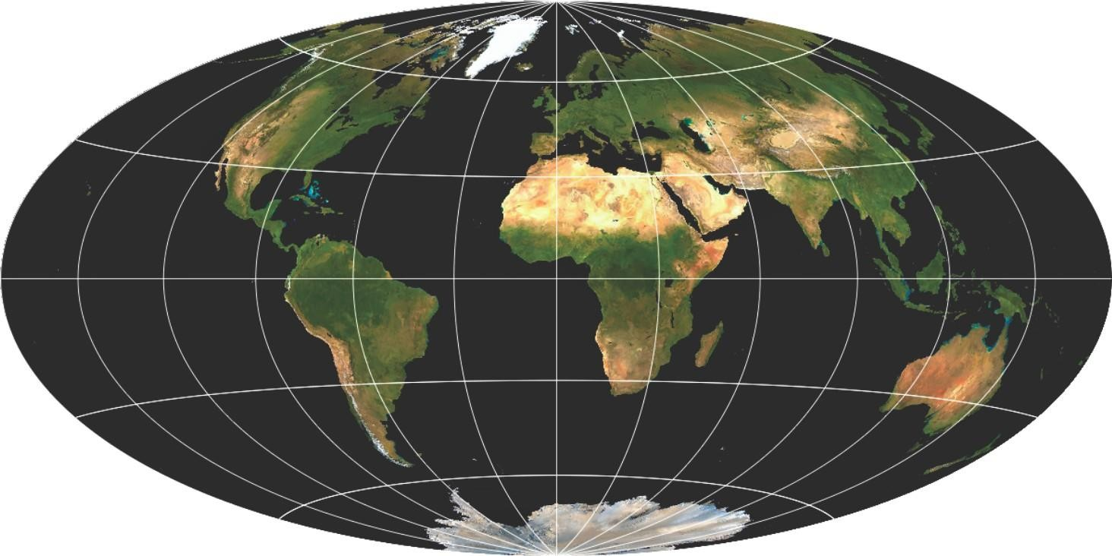
Hammer-Aitoff Projection
Equal area
Pseudocylindrical
Non conformal
Converging meridians
Reduced distortion in outer meridians
Curved parallels
"Interactive Data Visualisation", M. Ward, G Grinstein 8: D Keirn, AK Peters, 2010
"Interactive Data Visualisation", M. Ward, G Grinstein 8: D Keirn, AK Peters, 2010
Notes:
modification of the Lambert azimuthal equal area projection.
same 2:1 elliptical outer shape as the Mollweide projection, reduce distortion in the regions of the outer meridians, where it is extreme in the Mollweide
It is used most often for whole-world maps.
meridians are depicted as complex curves, unequally spaced along the Equator and concave toward the central meridian
parallels are depicted as complex curves, unequally spaced along the central meridian and concave toward the nearest pole.

Slide 38
Hammer-Aitoff Projection
"Interactive Data Visualisation", M. Ward, G Grinstein 8: D Keirn, AK Peters, 2010
"Interactive Data Visualisation", M. Ward, G Grinstein 8: D Keirn, AK Peters, 2010
Notes:
modification of the Lambert azimuthal equal area projection.
It is used most often for whole-world maps.
meridians are depicted as complex curves, unequally spaced along the Equator and concave toward the central meridian
parallels are depicted as complex curves, unequally spaced along the central meridian and concave toward the nearest pole.

Slide 39
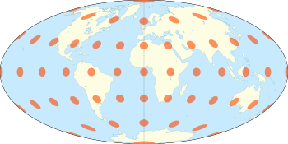
Hammer-Aitoff Projection
"Interactive Data Visualisation", M. Ward, G Grinstein 8: D Keirn, AK Peters, 2010

Slide 40
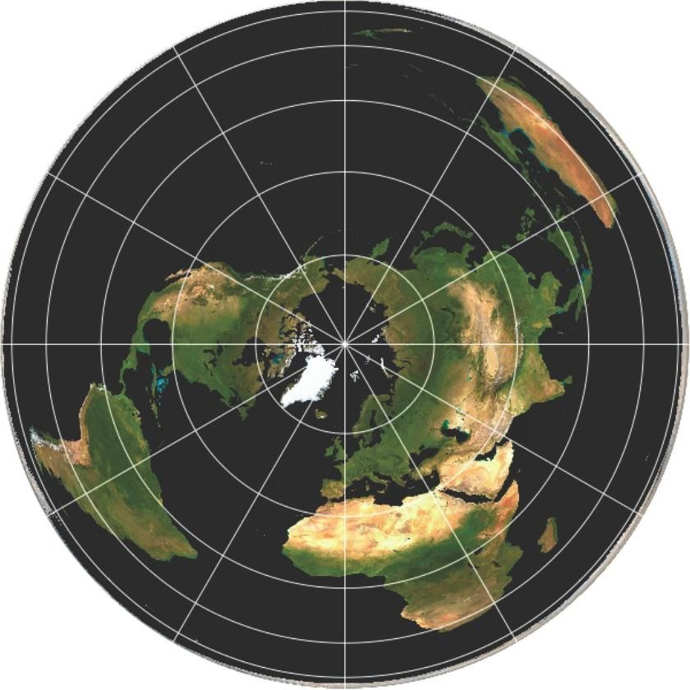
Albers Equal-area Conic Projection
Equal area
Uses 2 standard parallels to reduce distortion
Non conformal
Country or subcontinent view
Expanding East to West rather than North to South
USA geological survey
USA census
"Interactive Data Visualisation", M. Ward, G Grinstein 8: D Keirn, AK Peters, 2010
Notes:
Distances and scale are true only on both standard parallels with directions being reasonably accurate. Areas are equal to the same areas on Earth, though it’s not conformal, perspective, or equidistant.
Conformal map projections preserve angles if two roads cross each other at a 39° angle, then their images on a map with a conformal projection cross at a 39° angle.

Slide 41
Albers Equal-area Conic Projection
"Interactive Data Visualisation", M. Ward, G Grinstein 8: D Keirn, AK Peters, 2010
Notes:
Distances and scale are true only on both standard parallels with directions being reasonably accurate. Areas are equal to the same areas on Earth, though it’s not conformal, perspective, or equidistant.
Conformal map projections preserve angles if two roads cross each other at a 39° angle, then their images on a map with a conformal projection cross at a 39° angle.

Slide 42
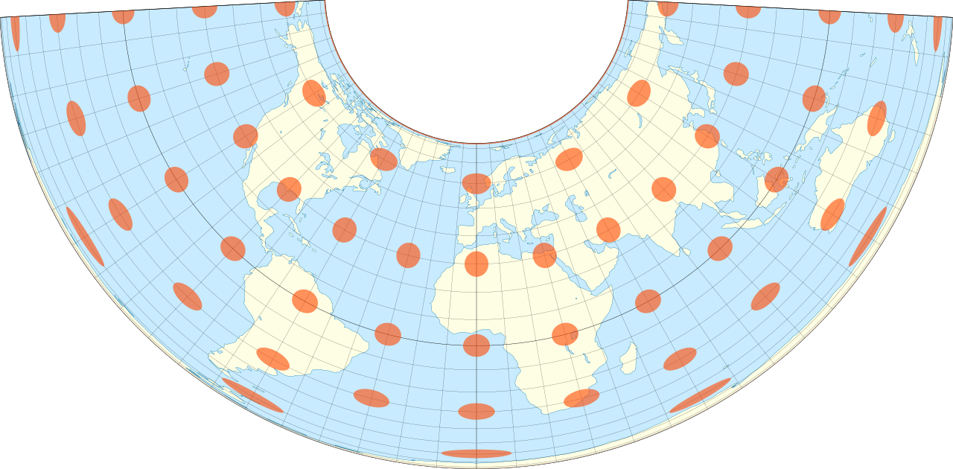
Albers Equal-area Conic Projection
"Interactive Data Visualisation", M. Ward, G Grinstein 8: D Keirn, AK Peters, 2010
Notes:
Distances and scale are true only on both standard parallels with directions being reasonably accurate. Areas are equal to the same areas on Earth, though it’s not conformal, perspective, or equidistant.
Conformal map projections preserve angles if two roads cross each other at a 39° angle, then their images on a map with a conformal projection cross at a 39° angle.

Slide 43
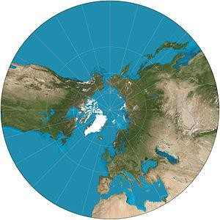
Gnomonic Azimuthal Projection
Hemisphere or continent level
Perspective, azimuthal projection
point of perspective at the centre of the globe
Great distortion of shape, area and scale
Except at the centre
Seismic work or navies plotting directions using radio waves
Notes:
The gnomonic projection is the perspective, azimuthal projection with point of perspective at the center of the globe. Hence, with the gnomonic projection, the interior of a hemispherical region of the globe is projected to the UV plane with the rim of the hemisphere going to infinity. Except at the center, there is great distortion of shape, area, and scale. The default clipping region for the gnomonic projection is a circle with a radius of 60 degrees at the center of projection

Slide 44
Gnomonic Azimuthal Projection
Notes:
The gnomonic projection is the perspective, azimuthal projection with point of perspective at the center of the globe. Hence, with the gnomonic projection, the interior of a hemispherical region of the globe is projected to the UV plane with the rim of the hemisphere going to infinity. Except at the center, there is great distortion of shape, area, and scale. The default clipping region for the gnomonic projection is a circle with a radius of 60 degrees at the center of projection

Slide 45
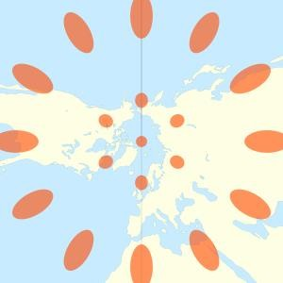
Gnomonic Azimuthal Projection

Slide 46
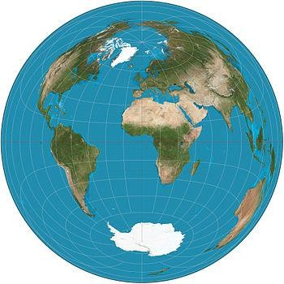
Lambert Azimuthal Equal Area Projection
Mapping sphere to a disk
Equal area
Non conformal
Does not accurately represent angles
Hemisphere or continent level
Geology – 3D mapping
European Environment Agency
Notes:
The Lambert azimuthal equal-area projection is a particular mapping from a sphere to a disk (that is, a region bounded by a circle). It accurately represents area in all regions of the sphere, but it does not accurately represent angles. I

Slide 47
Lambert Azimuthal Equal Area Projection
Notes:
The Lambert azimuthal equal-area projection is a particular mapping from a sphere to a disk (that is, a region bounded by a circle). It accurately represents area in all regions of the sphere, but it does not accurately represent angles. I

Slide 48
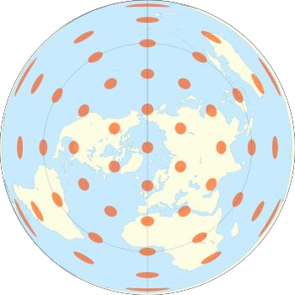
Lambert Azimuthal Equal Area Projection

Slide 49
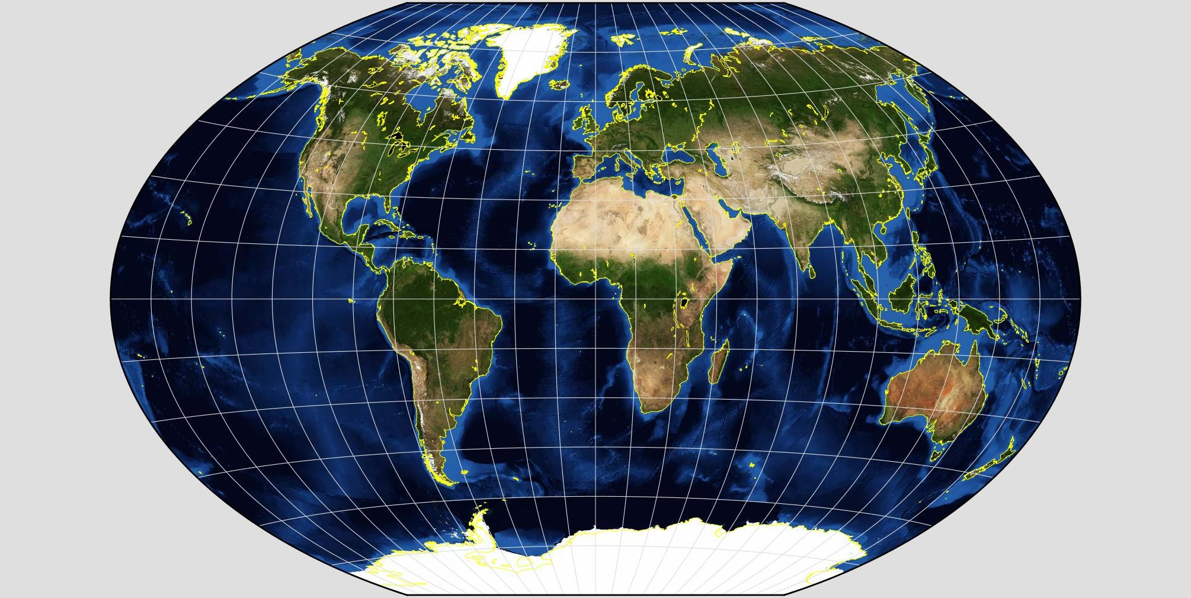
Winkel Tripel Projection
Compromise projection
Give up the idea of perfectly preserving metric properties
Instead, strike a balance between distortions
Neither conformal nor equal area
Minimizing distortions in area, direction, distance
Whole world maps
National Geographic
https://www.giss.nasa.gov/tools/gprojector/help/projections/
Notes:
Compromise projections give up the idea of perfectly preserving metric properties, seeking instead to strike a balance between distortions, or to simply make things "look right". Most of these types of projections distort shape in the polar regions more than at the equator. It is used primarily for whole world maps.
minimizing three kinds of distortion: area, direction, and distance
The Winkel Tripel projection is a modified azimuthal projection that is neither conformal nor equal area.

Slide 50
Winkel Tripel Projection
https://www.giss.nasa.gov/tools/gprojector/help/projections/
Notes:
Compromise projections give up the idea of perfectly preserving metric properties, seeking instead to strike a balance between distortions, or to simply make things "look right". Most of these types of projections distort shape in the polar regions more than at the equator. It is used primarily for whole world maps.
minimizing three kinds of distortion: area, direction, and distance
The Winkel Tripel projection is a modified azimuthal projection that is neither conformal nor equal area.

Slide 51
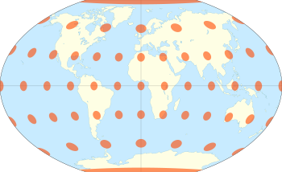
Winkel Tripel Projection
https://www.giss.nasa.gov/tools/gprojector/help/projections/
Notes:
Compromise projections give up the idea of perfectly preserving metric properties, seeking instead to strike a balance between distortions, or to simply make things "look right". Most of these types of projections distort shape in the polar regions more than at the equator. It is used primarily for whole world maps.
minimizing three kinds of distortion: area, direction, and distance
The Winkel Tripel projection is a modified azimuthal projection that is neither conformal nor equal area.

Slide 52
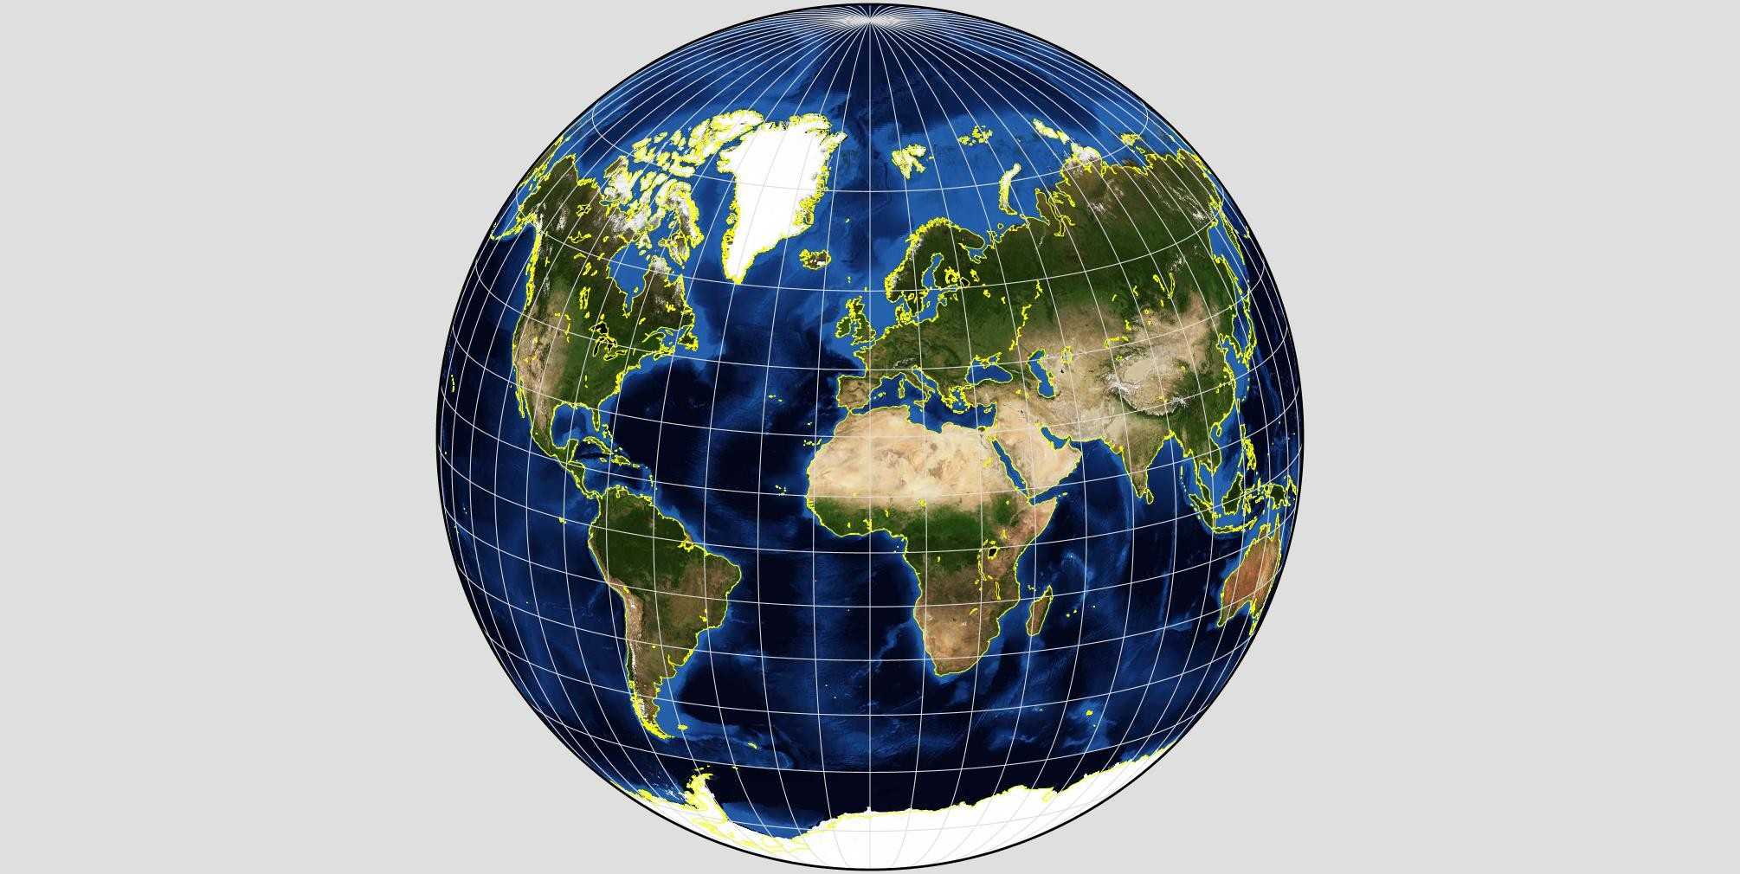
Gilbert Two world Perspective Projection
Illusion
All countries are shown, even though only half the globe is visible
Transformed conformally onto each hemisphere of a globe
Resembles the world as people increasingly see it
https://www.giss.nasa.gov/tools/gprojector/help/projections/
Notes:
Illusion - Notice how all countries are shown, even though only half the globe is visible?
the whole world has first been transformed conformally onto each hemisphere of a globe, using a construction by Edgar N. Gilbert, resulting in a globe with two images of the world, one on each hemisphere. It is then projected to 2D using the orthographic projection

Slide 53
Gilbert Two world Perspective Projection
https://www.giss.nasa.gov/tools/gprojector/help/projections/
Notes:
Illusion - Notice how all countries are shown, even though only half the globe is visible?
the whole world has first been transformed conformally onto each hemisphere of a globe, using a construction by Edgar N. Gilbert, resulting in a globe with two images of the world, one on each hemisphere. It is then projected to 2D using the orthographic projection

Slide 54
Projections in R
Different projections are included in the maps package

Slide 55
Projections in R
Equatorial projections centered on the Prime Meridian (longitude 0). Parallels are straight horizontal lines
mercator() equally spaced straight meridians, conformal, straight compass courses
gall(lat0) parallels spaced stereographically on prime meridian, equally spaced straight meridians, true scale on lat0
mollweide() equal-area, hemisphere is a circle
gilbert() sphere conformally mapped on hemisphere and viewed orthographically
Others
sinusoidal() cylindrical() rectangular(lat0) cylequalarea(lat0)
https://cran.r-project.org/web/packages/maps/maps.pdf

Slide 56
Projections in R
Azimuthal projections centered on the North Pole. Parallels are concentric circles. Meridians are equally spaced radial lines.
azequidistant() equally spaced parallels, true distances from pole
azequalarea() equal-area
gnomonic() central projection on tangent plane, straight great circles
perspective(dist) viewed along earth's axis dist earth radii from center of earth
Others
orthographic() stereographic() laue() fisheye(n) newyorker(r)
https://cran.r-project.org/web/packages/maps/maps.pdf

Slide 57
Projections in R
Polar conic projections symmetric about the Prime Meridian. Parallels are segments of concentric circles
conic(lat0) central projection on cone tangent at lat0
simpleconic(lat0,lat1) equally spaced parallels, true scale on lat0 and lat1
lambert(lat0,lat1) conformal, true scale on lat0 and lat1
albers(lat0,lat1) equal-area, true scale on lat0 and lat1
bonne(lat0) equally spaced parallels, equal-area, parallel lat0 developed from tangent cone
https://cran.r-project.org/web/packages/maps/maps.pdf

Slide 58
Using ggplot in R
Long Tables
Bar charts
Histograms
Scatter plot and Bubble charts
Line charts
Smoothing

Slide 59
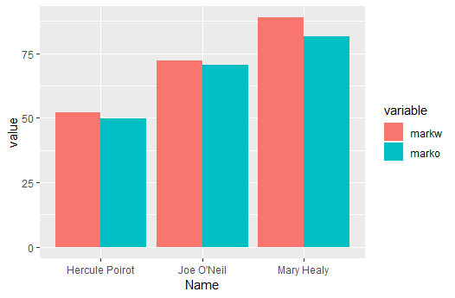
Long Tables in R
Looking at last week’s studentresults file, we may want to plot the results for the written and oral exams in two bars per student
In order to plot those results in a bar chart with written and oral in separate bars, we need to convert the table into what is called long table format

Slide 60
Long Tables in R
Original Table
Long Table
 | Name | markw | marko
1 | Hercule Poirot | 52.06667 | 49.73333
2 | Joe O'Neil | 72.20000 | 70.40000
3 | Mary Healy | 88.86667 | 81.40000
 | Name | variable | value
1 | Hercule Poirot | markw | 52.06667
2 | Joe O'Neil | markw | 72.20000
3 | Mary Healy | markw | 88.86667
4 | Hercule Poirot | marko | 49.73333
5 | Joe O'Neil | marko | 70.40000
6 | Mary Healy | marko | 81.40000

Slide 61
Long Tables in R
We can create the long table using the function melt from the reshape2 package:
library(reshape2)
resultsW_O2 <- sqldf ( "select Name, avg(Mark_Written) as markw,
avg(Mark_Oral) as marko from studentresult group by Name")
head(resultsW_O2)
resultsW_Om<-melt(resultsW_O2,id.vars = c('Name')) head(resultsW_Om)

Slide 62
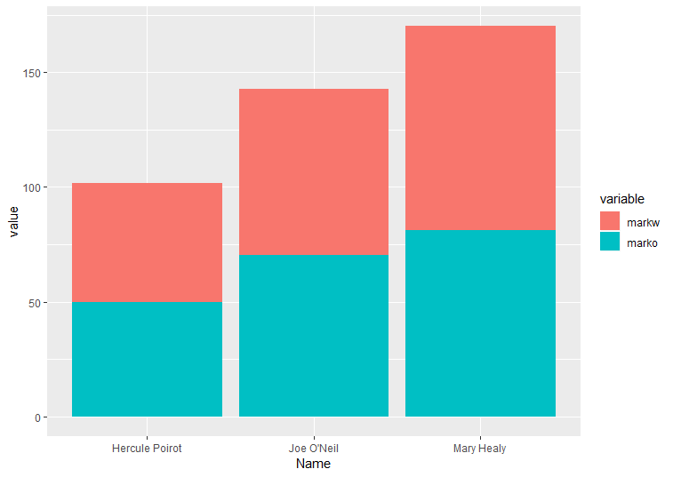
Long Tables in R
Now, we can use ggplot to plot the different values, using value for y axis and variable for fill colour, as well as position dodge to place written and oral bars beside each other instead of stacked.
ggplot(resultsW_Om, aes(x = Name, y = value, fill = variable) ) + geom_bar(stat="identity", position = 'dodge')

Slide 63
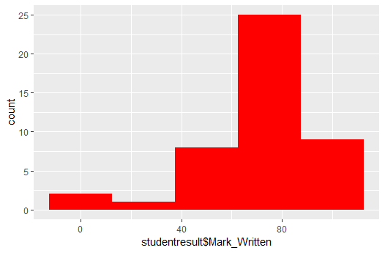
Visualisations using ggplot Histograms
Plots one variable counting the instances that fall in each bin. Bin size can be adjusted with the command binwidth.
ggplot(data=studentresult, aes(studentresult$Mark_Written)) + geom_histogram(fill='red',binwidth = 25)

Slide 64
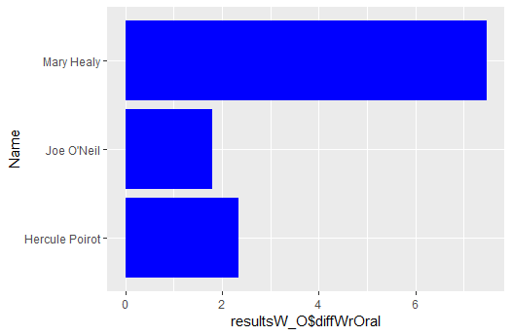
Visualisations using ggplot Horizontal Bar chart
ggplot(resultsW_O , aes(x = Name, y = resultsW_O$diffWrOral) ) + geom_bar(stat="identity",fill='blue')+coord_flip()

Slide 65
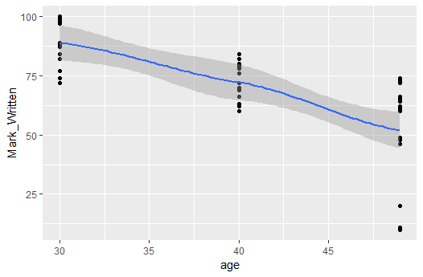
Visualisations using ggplot
Fitting lines and smoothing methods
Lines and curves can be fitted into scatter plots to help in the identification of patterns.
Options
method: LOESS, LM
se: confidence interval display(TRUE,FALSE)
Notes:
locally estimated scatterplot smoothing
linear model
se : logical value. If TRUE, confidence interval is displayed around smooth.

Slide 66
Visualisations using ggplot
Fitting lines and smoothing methods
Lines and curves can be fitted into scatter plots to help in the identification of patterns.
v<-ggplot(studentresult, aes(x = age, y =Mark_Written ) )
+geom_point()
v+geom_smooth(method='loess')

Slide 67
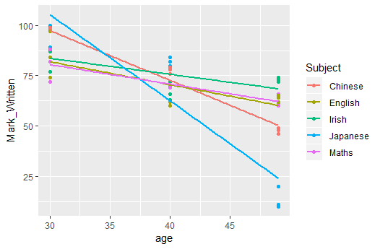
Visualisations using ggplot
Fitting lines and smoothing methods
Fitting separate lines for different data series (per subject)
v<-ggplot(studentresult, aes(x = age, y =Mark_Written ,color=Subject) )
+geom_point()
v+geom_smooth(method='lm',se=FALSE)

Slide 68
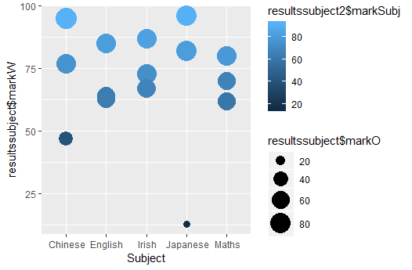
Visualisations using ggplot Bubble Charts
Bubble charts are created using ggplot by creating a scatter plot and adding the third dimension in the aesthetic option size.
A fourth dimension can be added using the colour fill.

Slide 69
Visualisations using ggplot Bubble Charts
ggplot(resultssubject, aes(x = Subject, y = resultssubject$markW)) +
geom_point(aes(size = resultssubject$markO, color=resultssubject2$markSubj)) + scale_size(range = c(3, 9))

Slide 70
Question for Lab
Find one message in our studentresult data
Create the best visualization to show the message

Slide 71
Assignment 2 – 30%
You are a Data Scientist. You are tasked with conducting some exploratory analysis. Your goal is to find “insights” in the data and present those findings to your colleagues.
Select, Clean and Wrangle a Dataset – 4%
Decide on a story (user story) – 2%
Using R, create three visualisations 21%
Show previous iterations or alternatives 3%

Slide 72
Thanks To
Marisa Llorens-Salvador, John McAuley, Colman McMahon and Brian Mac Namee for an earlier version of these lecture notes

